Slide 1
INTRODUCTION TO OFFICE AUTOMATION:
Presented by: Manal Asghar

Slide 2
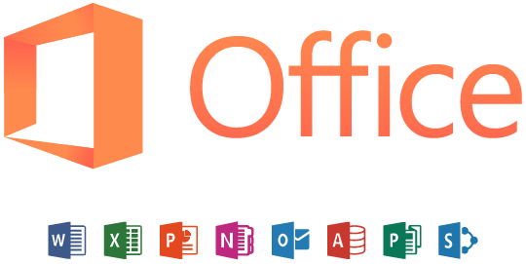
INTRODUCTION TO OFFICE AUTOMATION:
Microsoft Office (MS Office) is a suite of productivity software developed by Microsoft Corporation. It includes a collection of applications designed to help users perform various office-related tasks such as creating documents, managing data, making presentations, and handling emails.
Common programs in Office Automation include:
Microsoft Word :For creating and editing documents.
Example: Writing a report or a letter.
Microsoft Excel : For spreadsheets, calculations, and charts.
Example: Keeping a budget or making a sales chart.
Microsoft PowerPoint : For presentations and slideshows.
Example: Creating a school or office presentation.

Slide 3
INTRODUCTION TO OFFICE AUTOMATION:
Microsoft Outlook : For email, calendar, and contacts.
Example: Sending work emails and scheduling meetings.
Microsoft OneNote : For taking and organizing notes.
Example: Making notes for a class or meeting.
Microsoft Access : For creating and managing databases.
Example: Storing employee or student information.

Slide 4

Microsoft Word 2021
Microsoft Word 2021 is a word processing application.
It is used to create documents like letters, reports, and resumes.
It provides tools for formatting and professional document design.

Slide 5
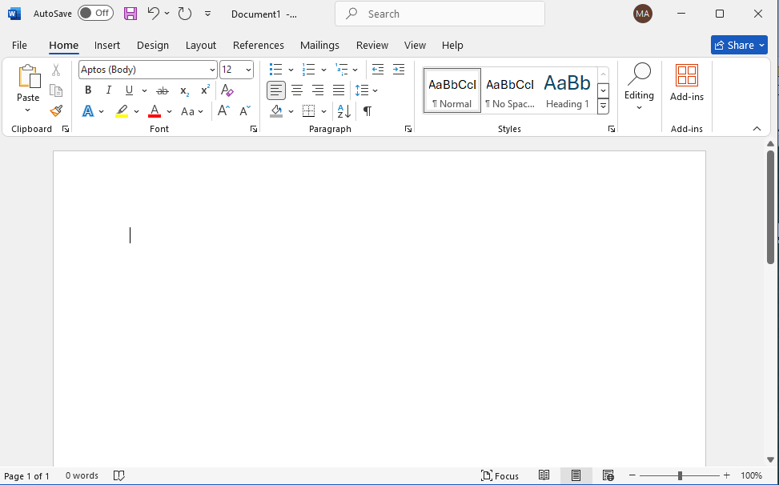
MS Word Interface
Quick access Toolbar
Tabs
Paragraph Group
Ribbon
Fonts Group
Title Bar
Scroll Bar
Status Bar

Slide 6
MS Word Interface Main Component
Title Bar : Shows the name of your document and the program (Microsoft Word).
Quick Access Toolbar : Has shortcut buttons for common actions like Save, Undo, and Redo.
Ribbon : Contains all the tools and commands you need to work in Word, arranged in tabs.
Tabs : These are the main sections on the Ribbon (like Home, Insert, Design) that group related tools together.
Groups : Each tab is divided into smaller parts (groups) that hold similar commands, like Font or Paragraph.
Status Bar : Shows information about your document, such as page number, word count, and language.
View Buttons : Let you switch between different ways to see your document (like Print Layout or Web Layout).
Zoom Slider : Lets you make your document look bigger or smaller on the screen.
Scroll Bars : Help you move up and down or side to side to view different parts of your document.
File Tab (Backstage View) : Opens options like New, Open, Save, Print, and Close for managing your documents.

Slide 7
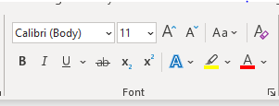
Font Group (in the Home Tab):
Font Type
Changes the style of letters
Font Size
Changes how big or small your text looks.
Bold (B)
Makes text thicker and darker.
Italic (I)
Slants the text to the right.
Underline (U)
Draws a line under the text.
Font type
Font Size
Bold
Italic
Under line

Slide 8
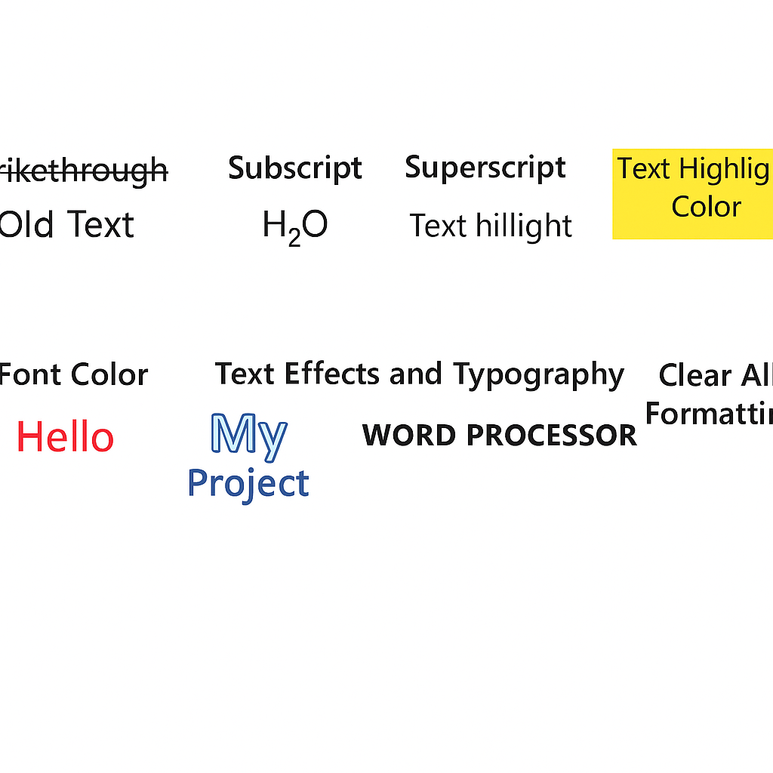
Font Group (in the Home Tab):
Strikethrough
Subscript
Superscript
Text Highlight Color
Font Color
Text Effects and Typography
Clear All Formatting

Slide 9
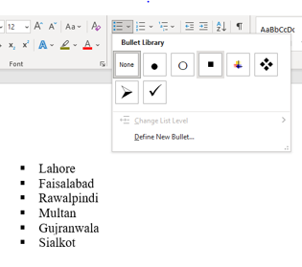
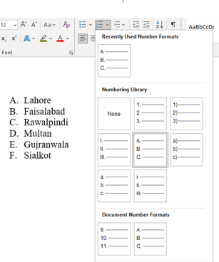
Paragraph Group (in the Home Tab)
Bullets (•)
Creates a list with dots for each item.
Example: A shopping list or points list
Numbering (1, 2, 3 …)
Creates a numbered list.
Example: Step-by-step instructions.

Slide 10
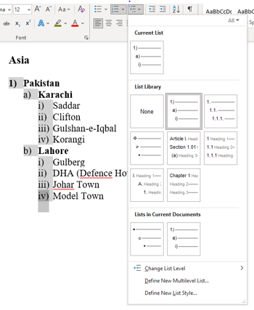
Multilevel List
Creates a hierarchical list with main points and sub-points.
Example: An outline with topics and subtopics.
4. Decrease/Increase Indent
Adjusts the left margin of a paragraph.
Increase = moves paragraph to the right
Decrease = moves it to the left.
5. Align Left
Aligns text to the left margin.
6. Center
Centers the text horizontally.
7. Align Right
Aligns text to the right margin.

Slide 11
Justify
Aligns text evenly on both left and right margins for a neat look
Line and Paragraph Spacing
Adjusts the space between lines and between paragraphs.
Shading (paint bucket icon)
Adds background color to a paragraph
Borders
Adds a border around the paragraph

Slide 12
Creating Custom Bulleted, Numbering & Multilevel Lists
Customized Bulleted List
Meaning: A list that uses special symbols (like ●, ✔, ★, →) before each item.
Use: When the order of items doesn’t matter.
How to Create in Word
Select the text.
Go to Home tab → Bullets dropdown arrow.
Click Define New Bullet.
Choose Symbol and select any symbol you like.

Slide 13
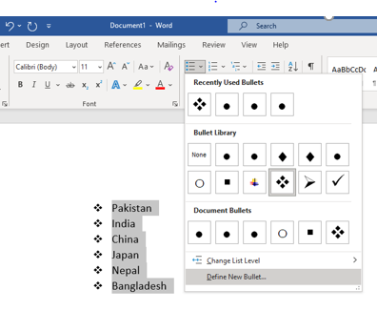
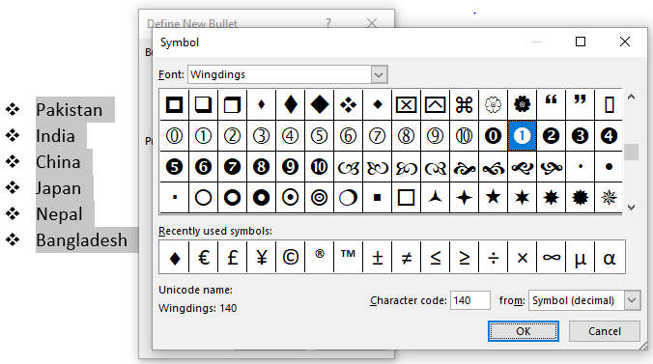
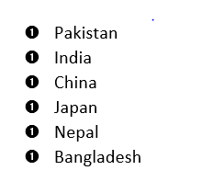
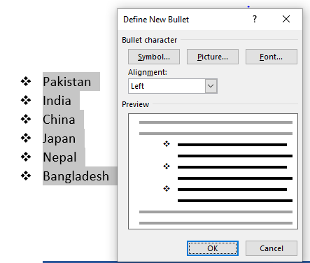
Steps of Creating Custom Bulleted
Step:03
Step:01
Step:04 (Press ok)
Step:02

Slide 14
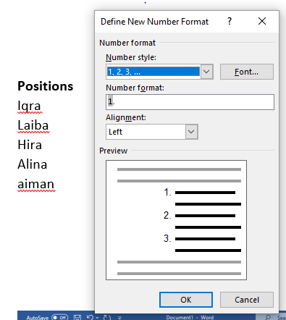
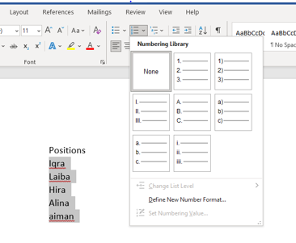
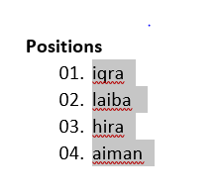
Steps of Creating Custom Numbering
Step:01
Step:02
Step:03(Press ok)

Slide 15
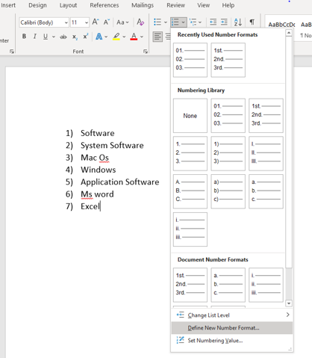
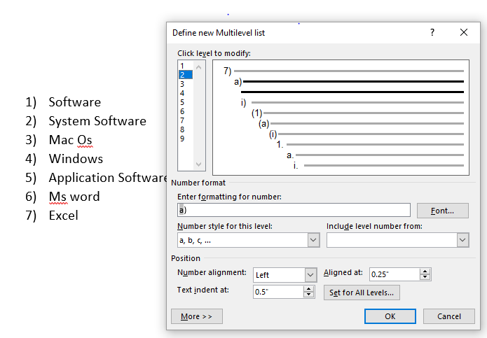
Steps of Creating Multilevel Lists
Step:01
Step:02 (Select Level)

